Slide 1
Binary I/O ,Recursion and Generics

Slide 2
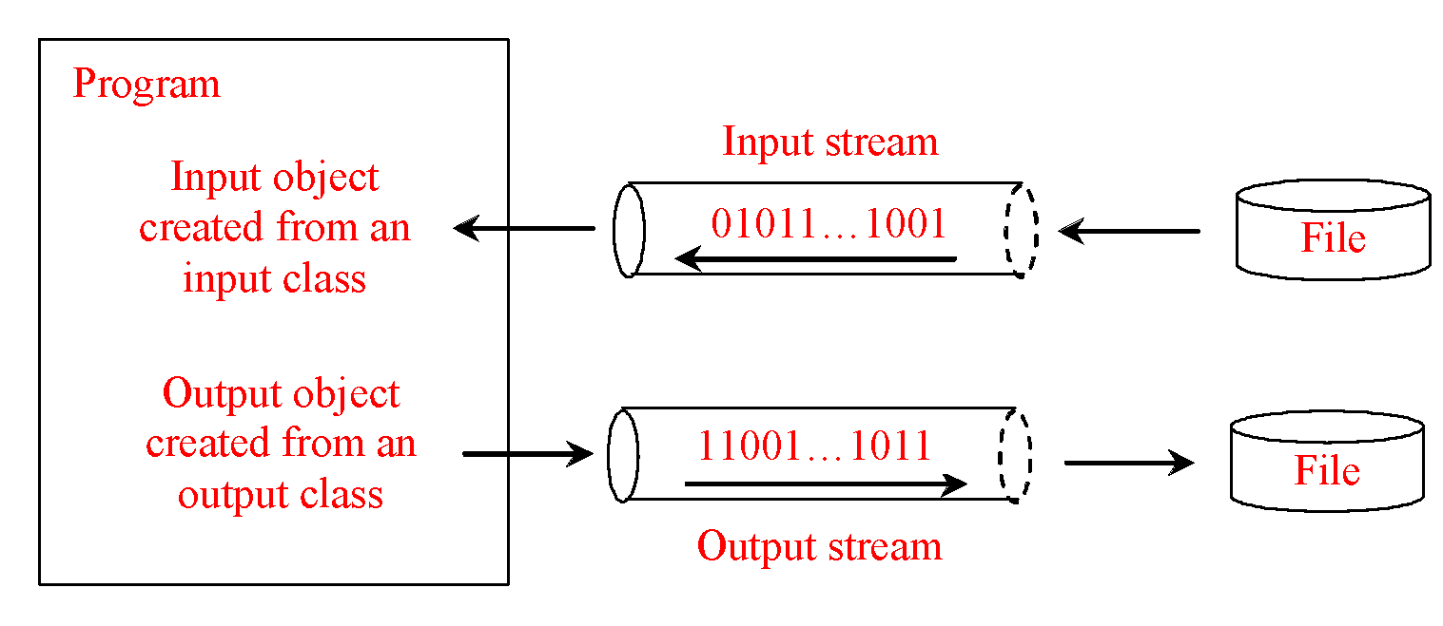
How is I/O Handled in Java?
A File object encapsulates the properties of a file or a path, but does not contain the methods for reading/writing data from/to a file. In order to perform I/O, you need to create objects using appropriate Java I/O classes.
Scanner input = new Scanner(new File("temp.txt"));
System.out.println(input.nextLine());
PrintWriter output = new PrintWriter("temp.txt");
output.println("Java 101");
output.close();

Slide 3
Text File vs. Binary File
Data stored in a text file are represented in human-readable form. Data stored in a binary file are represented in binary form. You cannot read binary files. Binary files are designed to be read by programs. For example, the Java source programs are stored in text files and can be read by a text editor, but the Java classes are stored in binary files and are read by the JVM. The advantage of binary files is that they are more efficient to process than text files.
Although it is not technically precise and correct, you can imagine that a text file consists of a sequence of characters and a binary file consists of a sequence of bits. For example, the decimal integer 199 is stored as the sequence of three characters: '1', '9', '9' in a text file and the same integer is stored as a byte-type value C7 in a binary file, because decimal 199 equals to hex C7.

Slide 4
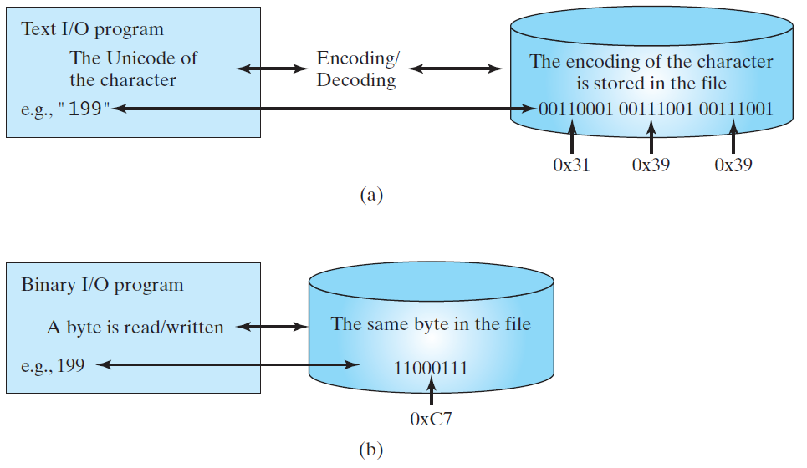
Binary I/O
Text I/O requires encoding and decoding. The JVM converts a Unicode to a file specific encoding when writing a character and converts a file specific encoding to a Unicode when reading a character. Binary I/O does not require conversions. When you write a byte to a file, the original byte is copied into the file. When you read a byte from a file, the exact byte in the file is returned.

Slide 5
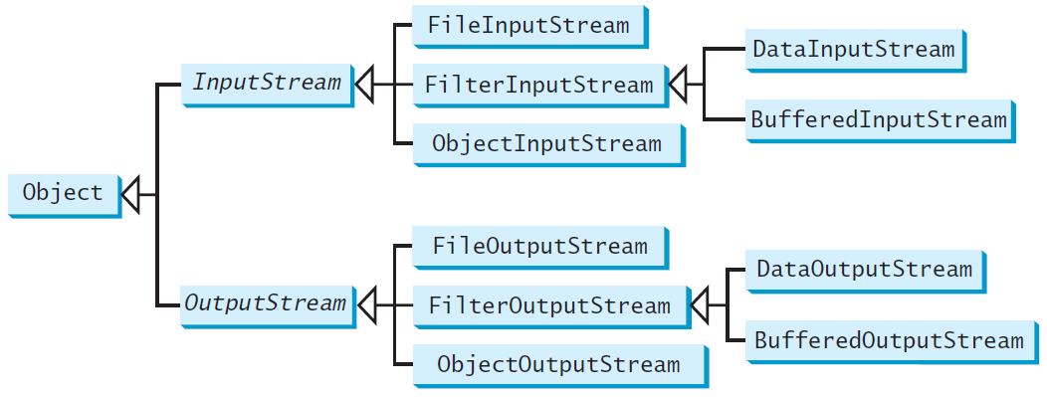
Binary I/O Classes

Slide 6
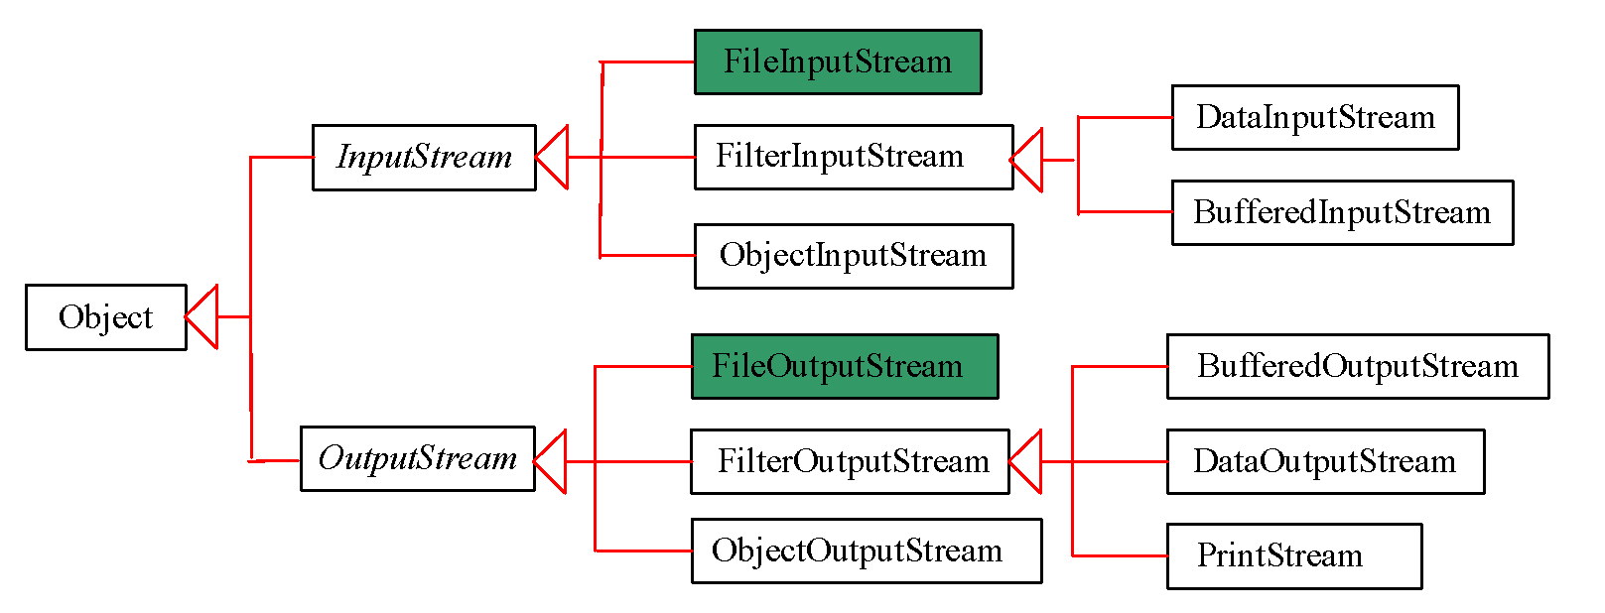
FileInputStream/FileOutputStream
FileInputStream/FileOutputStream associates a binary input/output stream with an external file. All the methods in FileInputStream/FileOuptputStream are inherited from its superclasses.

Slide 7
FileInputStream
To construct a FileInputStream, use the following constructors:
public FileInputStream(String filename)
public FileInputStream(File file)
A java.io.FileNotFoundException would occur if you attempt to create a FileInputStream with a nonexistent file.

Slide 8
FileOutputStream
To construct a FileOutputStream, use the following constructors:
public FileOutputStream(String filename)
public FileOutputStream(File file)
public FileOutputStream(String filename, boolean append)
public FileOutputStream(File file, boolean append)
If the file does not exist, a new file would be created. If the file already exists, the first two constructors would delete the current contents in the file. To retain the current content and append new data into the file, use the last two constructors by passing true to the append parameter.

Slide 9
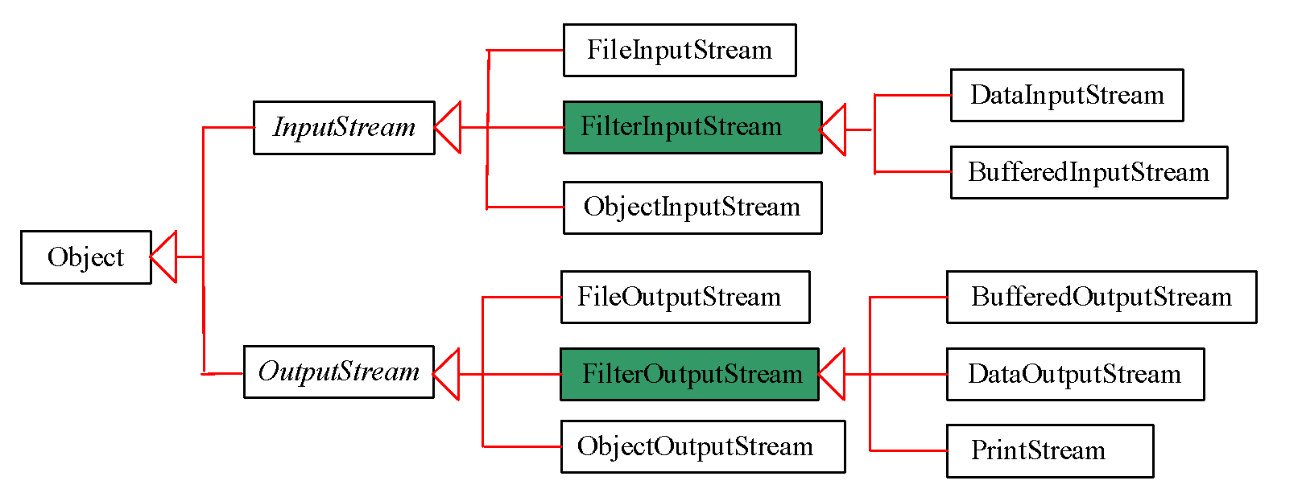
FilterInputStream/FilterOutputStream
Filter streams are streams that filter bytes for some purpose. The basic byte input stream provides a read method that can only be used for reading bytes. If you want to read integers, doubles, or strings, you need a filter class to wrap the byte input stream. Using a filter class enables you to read integers, doubles, and strings instead of bytes and characters. FilterInputStream and FilterOutputStream are the base classes for filtering data. When you need to process primitive numeric types, use DataInputStream and DataOutputStream to filter bytes.

Slide 10
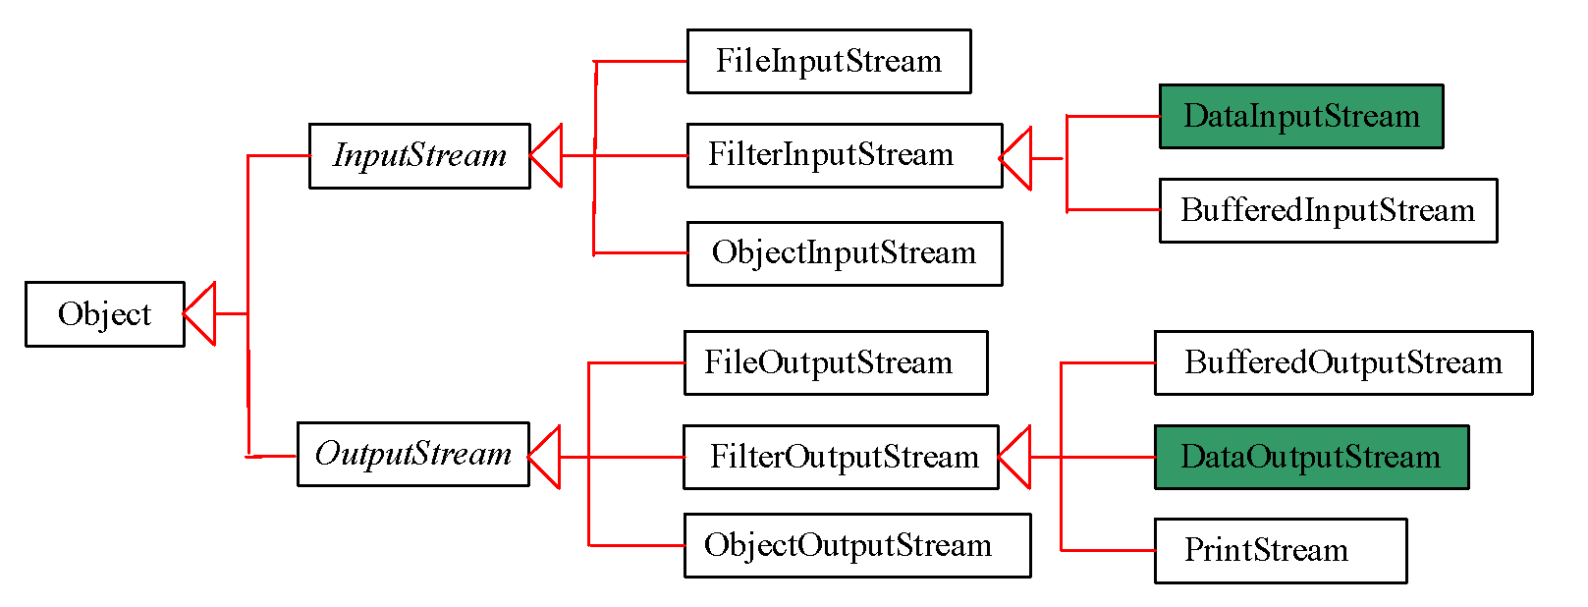
DataInputStream/DataOutputStream
DataInputStream reads bytes from the stream and converts them into appropriate primitive type values or strings.
DataOutputStream converts primitive type values or strings into bytes and output the bytes to the stream.

Slide 11
Characters and Strings in Binary I/O
A Unicode consists of two bytes. The writeChar(char c) method writes the Unicode of character c to the output. The writeChars(String s) method writes the Unicode for each character in the string s to the output.
Why UTF-8? What is UTF-8?
UTF-8 (Unicode Transformation Format) is a coding scheme that allows systems to operate with both ASCII and Unicode efficiently. Most operating systems use ASCII. Java uses Unicode. The ASCII character set is a subset of the Unicode character set. Since most applications need only the ASCII character set, it is a waste to represent an 8-bit ASCII character as a 16-bit Unicode character. The UTF-8 is an alternative scheme that stores a character using 1, 2, or 3 bytes. ASCII values (less than 0x7F) are coded in one byte. Unicode values less than 0x7FF are coded in two bytes. Other Unicode values are coded in three bytes.

Slide 12
Using DataInputStream/DataOutputStream
Data streams are used as wrappers on existing input and output streams to filter data in the original stream. They are created using the following constructors:
public DataInputStream(InputStream instream)
public DataOutputStream(OutputStream outstream)
The statements given below create data streams. The first statement creates an input stream for file in.dat; the second statement creates an output stream for file out.dat.
DataInputStream infile = new DataInputStream(new FileInputStream("in.dat"));
DataOutputStream outfile = new DataOutputStream(new FileOutputStream("out.dat"));

Slide 13
Checking End of File
Order and Format
CAUTION: You have to read the data in the same order and same format in which they are stored. For example, since names are written in UTF-8 using writeUTF, you must read names using readUTF.
TIP: If you keep reading data at the end of a stream, an EOFException would occur. So how do you check the end of a file? You can use input.available() to check it. input.available() == 0 indicates that it is the end of a file.

Slide 14
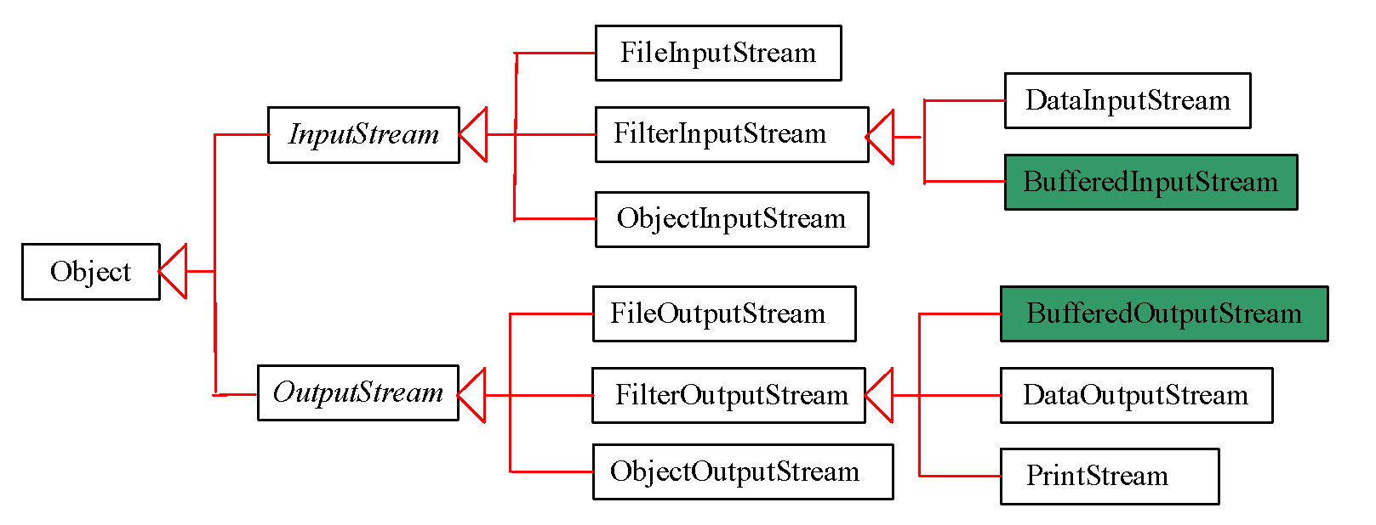
BufferedInputStream / BufferedOutputStream
Using buffers to speed up I/O
BufferedInputStream/BufferedOutputStream does not contain new methods. All the methods BufferedInputStream/BufferedOutputStream are inherited from the InputStream/OutputStream classes.

Slide 15
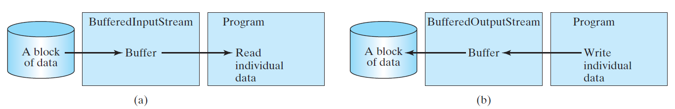
Constructing BufferedInputStream/BufferedOutputStream
// Create a BufferedInputStream
public BufferedInputStream(InputStream in)
public BufferedInputStream(InputStream in, int bufferSize)
// Create a BufferedOutputStream
public BufferedOutputStream(OutputStream out)
public BufferedOutputStream(OutputStream out, int bufferSize)

Slide 16
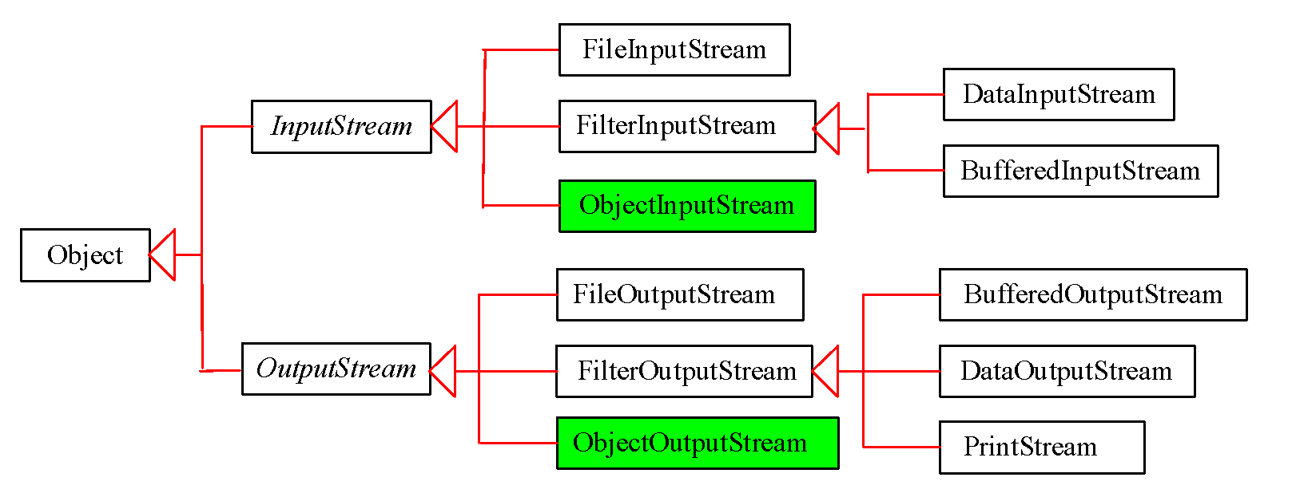
Object I/O
DataInputStream/DataOutputStream enables you to perform I/O for primitive type values and strings. ObjectInputStream/ObjectOutputStream enables you to perform I/O for objects in addition for primitive type values and strings.

Slide 17
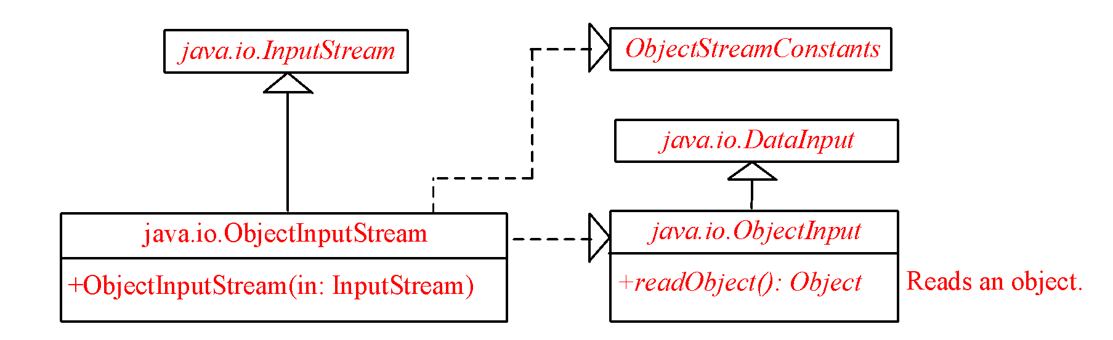
ObjectInputStream
ObjectInputStream extends InputStream and implements ObjectInput and ObjectStreamConstants.

Slide 18
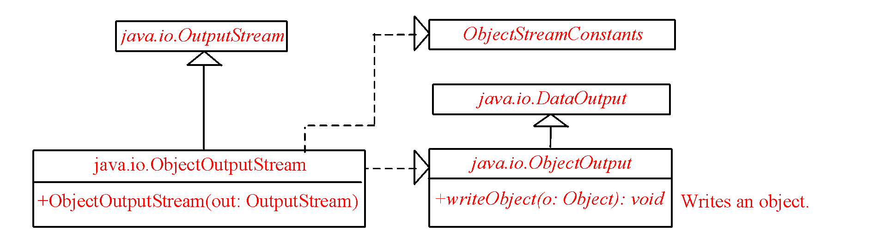
ObjectOutputStream
ObjectOutputStream extends OutputStream and implements ObjectOutput and ObjectStreamConstants.

Slide 19
Using Object Streams
You may wrap an ObjectInputStream/ObjectOutputStream on any InputStream/OutputStream using the following constructors:
// Create an ObjectInputStream
public ObjectInputStream(InputStream in)
// Create an ObjectOutputStream
public ObjectOutputStream(OutputStream out)

Slide 20
Random Access Files
All of the streams you have used so far are known as read-only or write-only streams. The external files of these streams are sequential files that cannot be updated without creating a new file. It is often necessary to modify files or to insert new records into files. Java provides the RandomAccessFile class to allow a file to be read from and write to at random locations.

Slide 21
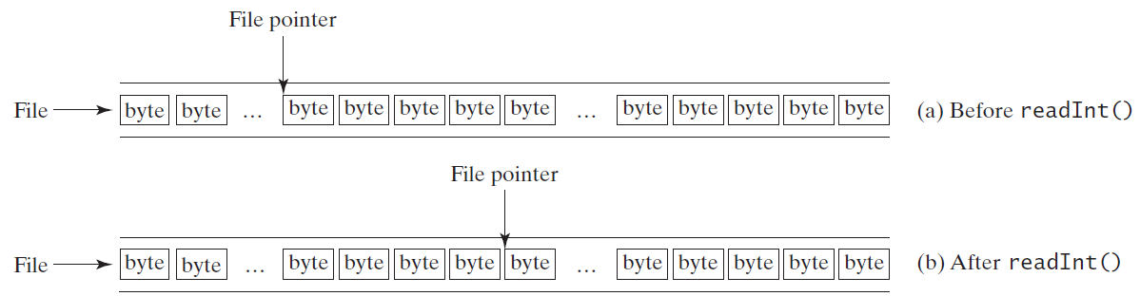
File Pointer
A random access file consists of a sequence of bytes. There is a special marker called file pointer that is positioned at one of these bytes. A read or write operation takes place at the location of the file pointer. When a file is opened, the file pointer sets at the beginning of the file. When you read or write data to the file, the file pointer moves forward to the next data. For example, if you read an int value using readInt(), the JVM reads four bytes from the file pointer and now the file pointer is four bytes ahead of the previous location.

Slide 22
RandomAccessFile Methods
Many methods in RandomAccessFile are the same as those in DataInputStream and DataOutputStream. For example, readInt(), readLong(), writeDouble(), readLine(), writeInt(), and writeLong() can be used in data input stream or data output stream as well as in RandomAccessFile streams.

Slide 23
RandomAccessFile Methods, cont.
void seek(long pos) throws IOException;
Sets the offset from the beginning of the RandomAccessFile stream to where the next read or write occurs.
long getFilePointer() IOException;
Returns the current offset, in bytes, from the beginning of the file to where the next read or write occurs.

Slide 24
RandomAccessFile Methods, cont.
long length()IOException
Returns the length of the file.
final void writeChar(int v) throws IOException
Writes a character to the file as a two-byte Unicode, with the high byte written first.
final void writeChars(String s) throws IOException
Writes a string to the file as a sequence of characters.

Slide 25
RandomAccessFile Constructor
RandomAccessFile raf = new RandomAccessFile("test.dat", "rw"); // allows read and write
RandomAccessFile raf = new RandomAccessFile("test.dat", "r"); // read only

Slide 26
Recursion

Slide 27
Computing Factorial
factorial(0) = 1;
factorial(n) = n*factorial(n-1);
n! = n * (n-1)!

Slide 28
Computing Factorial
factorial(0) = 1;
factorial(n) = n*factorial(n-1);
factorial(3)

Slide 29
Computing Factorial
factorial(0) = 1;
factorial(n) = n*factorial(n-1);
factorial(3) = 3 * factorial(2)

Slide 30
Computing Factorial
factorial(0) = 1;
factorial(n) = n*factorial(n-1);
factorial(3) = 3 * factorial(2)
= 3 * (2 * factorial(1))

Slide 31
Computing Factorial
factorial(0) = 1;
factorial(n) = n*factorial(n-1);
factorial(3) = 3 * factorial(2)
= 3 * (2 * factorial(1))
= 3 * ( 2 * (1 * factorial(0)))

Slide 32
Computing Factorial
factorial(0) = 1;
factorial(n) = n*factorial(n-1);
factorial(3) = 3 * factorial(2)
= 3 * (2 * factorial(1))
= 3 * ( 2 * (1 * factorial(0)))
= 3 * ( 2 * ( 1 * 1)))

Slide 33
Computing Factorial
factorial(0) = 1;
factorial(n) = n*factorial(n-1);
factorial(3) = 3 * factorial(2)
= 3 * (2 * factorial(1))
= 3 * ( 2 * (1 * factorial(0)))
= 3 * ( 2 * ( 1 * 1)))
= 3 * ( 2 * 1)

Slide 34
Computing Factorial
factorial(0) = 1;
factorial(n) = n*factorial(n-1);
factorial(3) = 3 * factorial(2)
= 3 * (2 * factorial(1))
= 3 * ( 2 * (1 * factorial(0)))
= 3 * ( 2 * ( 1 * 1)))
= 3 * ( 2 * 1)
= 3 * 2

Slide 35
Computing Factorial
factorial(0) = 1;
factorial(n) = n*factorial(n-1);
factorial(4) = 4 * factorial(3)
= 4 * 3 * factorial(2)
= 4 * 3 * (2 * factorial(1))
= 4 * 3 * ( 2 * (1 * factorial(0)))
= 4 * 3 * ( 2 * ( 1 * 1)))
= 4 * 3 * ( 2 * 1)
= 4 * 3 * 2
= 4 * 6
= 24

Slide 36
Characteristics of Recursion
All recursive methods have the following characteristics:
One or more base cases (the simplest case) are used to stop recursion.
Every recursive call reduces the original problem, bringing it increasingly closer to a base case until it becomes that case.
In general, to solve a problem using recursion, you break it into subproblems. If a subproblem resembles the original problem, you can apply the same approach to solve the subproblem recursively. This subproblem is almost the same as the original problem in nature with a smaller size.

Slide 37
Problem Solving Using Recursion
Let us consider a simple problem of printing a message for n times. You can break the problem into two subproblems: one is to print the message one time and the other is to print the message for n-1 times. The second problem is the same as the original problem with a smaller size. The base case for the problem is n==0. You can solve this problem using recursion as follows:
public static void nPrintln(String message, int times) {
if (times >= 1) {
System.out.println(message);
nPrintln(message, times - 1);
} // The base case is times == 0
}

Slide 38
Think Recursively
Many of the problems presented in the early chapters can be solved using recursion if you think recursively. For example, the palindrome problem can be solved recursively as follows:
public static boolean isPalindrome(String s) {
if (s.length() <= 1) // Base case
return true;
else if (s.charAt(0) != s.charAt(s.length() - 1)) // Base case
return false;
else
return isPalindrome(s.substring(1, s.length() - 1));
}

Slide 39
Recursive Helper Methods
The preceding recursive isPalindrome method is not efficient, because it creates a new string for every recursive call. To avoid creating new strings, use a helper method:
public static boolean isPalindrome(String s) {
return isPalindrome(s, 0, s.length() - 1);
}
public static boolean isPalindrome(String s, int low, int high) {
if (high <= low) // Base case
return true;
else if (s.charAt(low) != s.charAt(high)) // Base case
return false;
else
return isPalindrome(s, low + 1, high - 1);
}

Slide 40
Recursion
Recursion is an alternative form of program control. It is essentially repetition without a loop.
Recursion bears substantial overhead. Each time the program calls a method, the system must assign space for all of the method’s local variables and parameters. This can consume considerable memory and requires extra time to manage the additional space.

Slide 41
Advantages of Using Recursion
Recursion is good for solving the problems that are inherently recursive.

Slide 42
Tail Recursion
A recursive method is said to be tail recursive if there are no pending operations to be performed on return from a recursive call.

Slide 43
Why Do You Get a Warning?
public class ShowUncheckedWarning {
public static void main(String[] args) {
java.util.ArrayList list =
new java.util.ArrayList();
list.add("Java Programming");
}
}
To understand the compile warning on this line, you need to learn JDK 1.5 generics.

Slide 44
Fix the Warning
public class ShowUncheckedWarning {
public static void main(String[] args) {
java.util.ArrayList<String> list =
new java.util.ArrayList<String>();
list.add("Java Programming");
}
}
`
No compile warning on this line.

Slide 45
What is Generics?
Generics is the capability to parameterize types. With this capability, you can define a class or a method with generic types that can be substituted using concrete types by the compiler. For example, you may define a generic stack class that stores the elements of a generic type. From this generic class, you may create a stack object for holding strings and a stack object for holding numbers. Here, strings and numbers are concrete types that replace the generic type.

Slide 46
Why Generics?
The key benefit of generics is to enable errors to be detected at compile time rather than at runtime. A generic class or method permits you to specify allowable types of objects that the class or method may work with. If you attempt to use the class or method with an incompatible object, the compile error occurs.

Slide 47
Generic Instantiation
Runtime error
Improves reliability
Compile error

Slide 48
No Casting Needed
ArrayList<Double> list = new ArrayList<Double>();
list.add(5.5); // 5.5 is automatically converted to new Double(5.5)
list.add(3.0); // 3.0 is automatically converted to new Double(3.0)
Double doubleObject = list.get(0); // No casting is needed
double d = list.get(1); // Automatically converted to double

Slide 49
Declaring Generic Classes and Interfaces

Slide 50
Raw Type and Backward Compatibility
// raw type
ArrayList list = new ArrayList();
This is roughly equivalent to
ArrayList<Object> list = new ArrayList<Object>();

Slide 51
Raw Type is Unsafe
// Max.java: Find a maximum object
public class Max {
/** Return the maximum between two objects */
public static Comparable max(Comparable o1, Comparable o2) {
if (o1.compareTo(o2) > 0)
return o1;
else
return o2;
}
}
Runtime Error:
Max.max("Welcome", 23);

Slide 52
Make it Safe
// Max1.java: Find a maximum object
public class Max1 {
/** Return the maximum between two objects */
public static <E extends Comparable<E>> E max(E o1, E o2) {
if (o1.compareTo(o2) > 0)
return o1;
else
return o2;
}
}
Max.max("Welcome", 23);

Slide 53
Avoiding Unsafe Raw Types
Use
new ArrayList<ConcreteType>()
Instead of
new ArrayList();

Slide 54
Erasure and Restrictions on Generics
Generics are implemented using an approach called type erasure. The compiler uses the generic type information to compile the code, but erases it afterwards. So the generic information is not available at run time. This approach enables the generic code to be backward-compatible with the legacy code that uses raw types.

Slide 55
Compile Time Checking
For example, the compiler checks whether generics is used correctly for the following code in (a) and translates it into the equivalent code in (b) for runtime use. The code in (b) uses the raw type.

Slide 56
Important Facts
It is important to note that a generic class is shared by all its instances regardless of its actual generic type.
GenericStack<String> stack1 = new GenericStack<String>();
GenericStack<Integer> stack2 = new GenericStack<Integer>();
Although GenericStack<String> and GenericStack<Integer> are two types, but there is only one class GenericStack loaded into the JVM.

Slide 57
Restrictions on Generics
Restriction 1: Cannot Create an Instance of a Generic Type. (i.e., new E()).
Restriction 2: Generic Array Creation is Not Allowed. (i.e., new E[100]).
Restriction 3: A Generic Type Parameter of a Class Is Not Allowed in a Static Context.
Restriction 4: Exception Classes Cannot be Generic.

